Slide 1
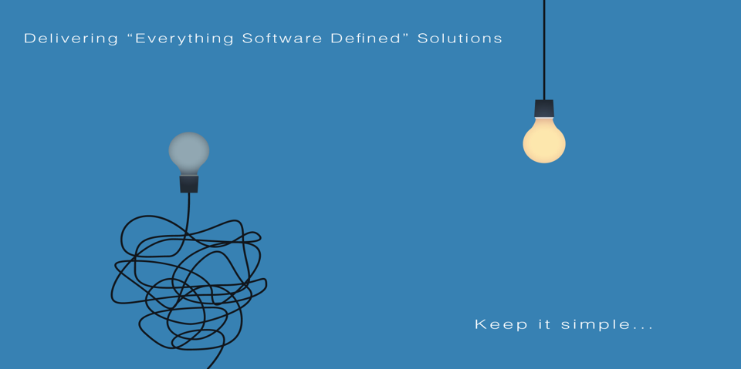
All information contained in this document and communicated to you by synectiks is confidential and proprietary to synectiks (“confidential information”). The information and any pricing data submitted here is non-binding and for evaluation purposes only and is subject to adjustment or modification by synectiks after its review, consideration, and negotiation of the terms and conditions of a definitive final contract. The data and information contained herein may not be reproduced, published or distributed to, or for, any third parties without the express prior written consent of synectiks.

Slide 2

  Managed Services Proposal
  For

Slide 3

Synectiks

Slide 4
Synectiks Highlights
Best-in-Class Infrastructure and Application Automation
Up to 60% Reduction in Manual Verification Effort
Continuous Delivery, Continuous Audit
Skilled Resource Pool for Managed Services
Real-time Visibility
Improved End-User Experience
Dedicated Support Manager
Monthly Account Review Meeting

Slide 5
Managed Services Proposal

Slide 6

First Federal Current Approach & Challenges
Multiple Tools & Teams
Repeated Jobs
Multiple Application Delivery
Semi Automated Verification
Private Cloud
More Workloads per Resource
Inconsistent End-User Experience
Long Mean Time to Repair
Release
TCO
Scale
© 2018 SYNECTIKS. all rights reserved. proprietary and confidential.

Slide 7
First Federal Requirements
First Federal Goals
  Reduce workloads through effective Automation
  Managed Services towards Private cloud evolution and optimization
  Application delivery through quality gates verification
  Visibility to end users experience
  Continuous Audit & Compliance
  TCO Reduction

Slide 8
Synectiks Solution

Slide 9




/Automation Platform
Master
Runs automations / audits / patches / application delivery / tests jobs into 1 single elastic cluster
Every job is written in python, in 1 single unified way, easily plugged to automation platform
Real-time visibility + diagnostics
Resilience
Agility
Reliability / Manageability / Extension
Elastic
Automation Bots
Continuous Audits
Continuous Delivery
Real-Time
Workforce
Workforce
Workforce
Time Series DB
Search DB
Resilient
MGMT(Visibility)

Slide 10
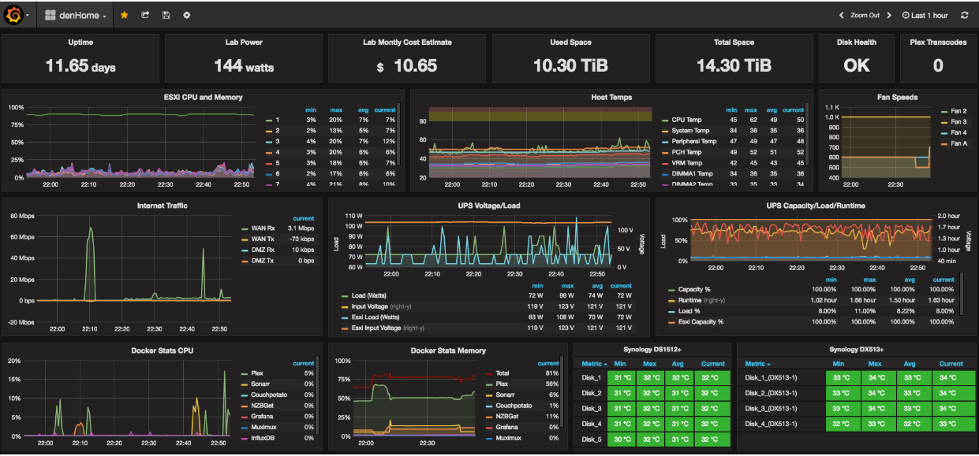
Visibility

Slide 11
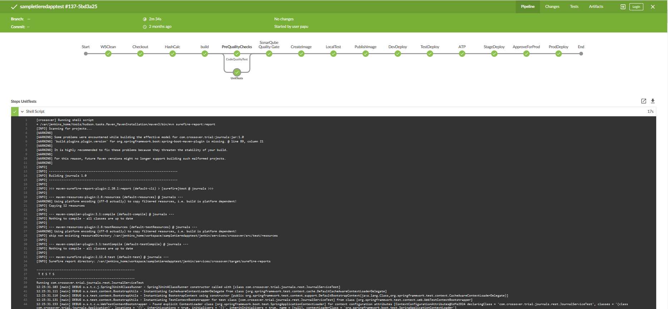
Continuous Delivery

Slide 12
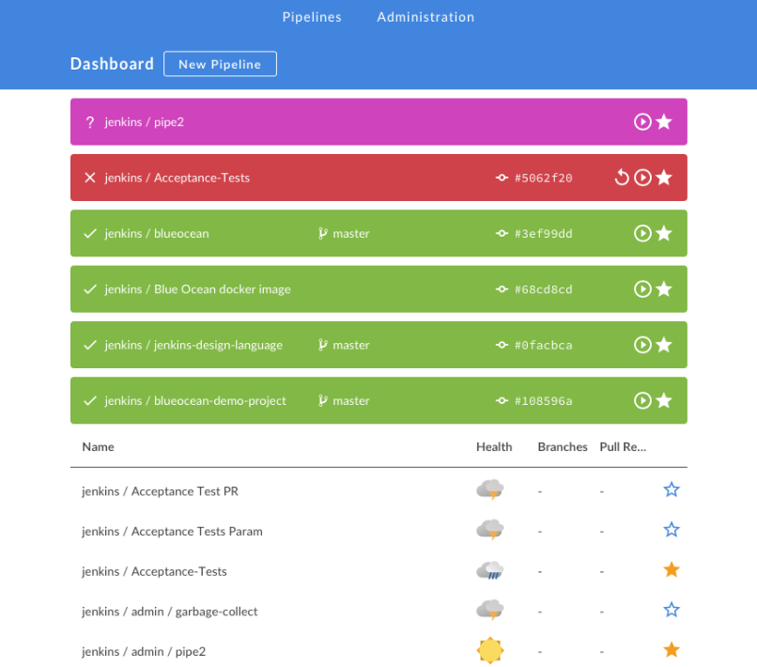
Continuous Delivery

Slide 13
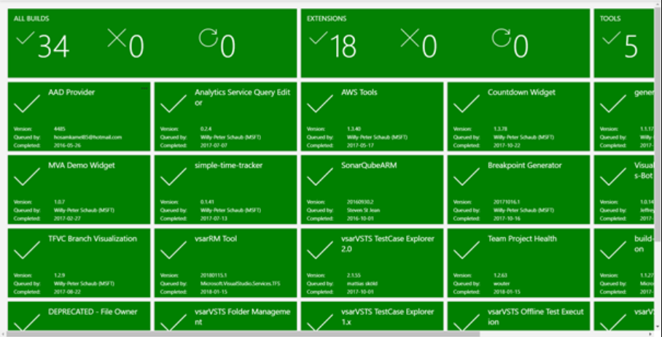
Continuous Delivery

Slide 14
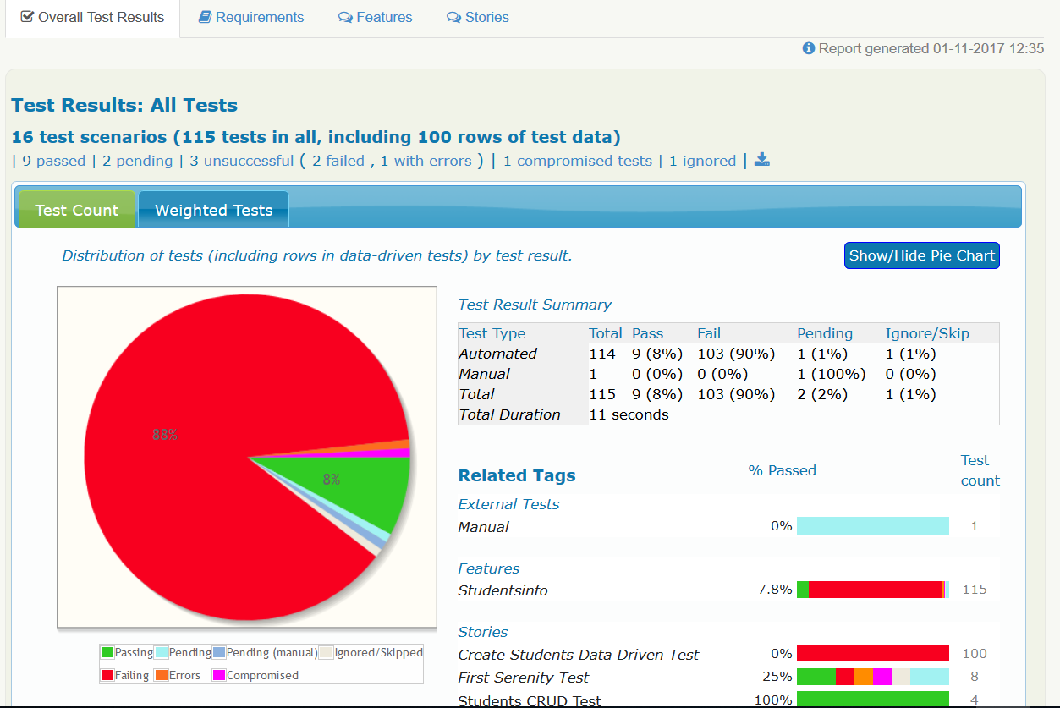
Service Quality Center

Slide 15
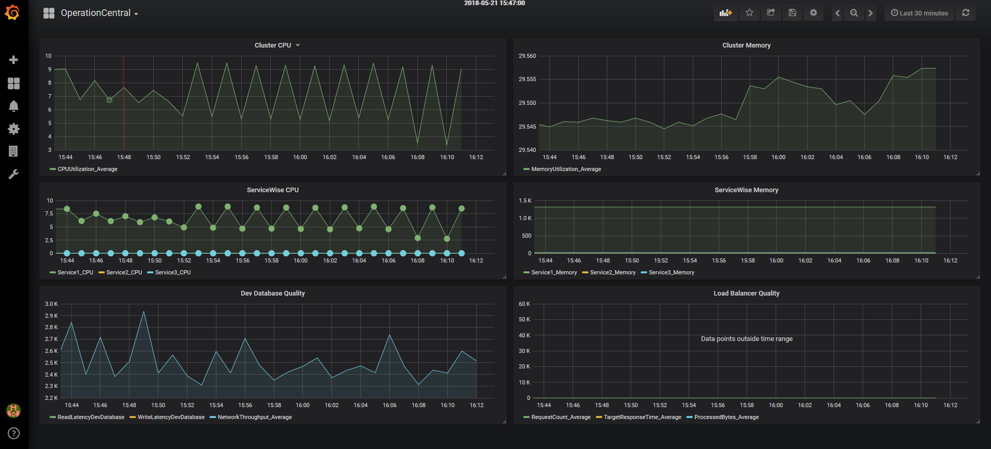
Operation Control

